Slide 1
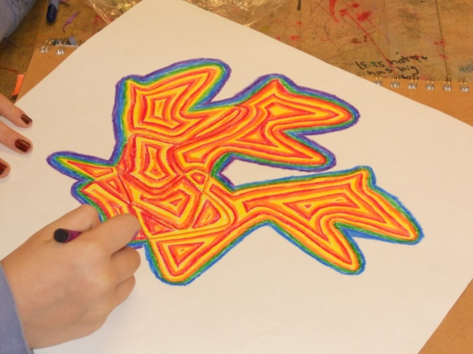
Warm and Cool Abstract Line Designs
Objectives:
T.S.W.
Students will explore the art elements “COLOR” and “SHAPE” in order to accurately identify warm and cool color schemes along with geometric and organic shapes.
Apply knowledge of COLOR and SHAPE to create a warm and cool abstract line design.

Slide 2
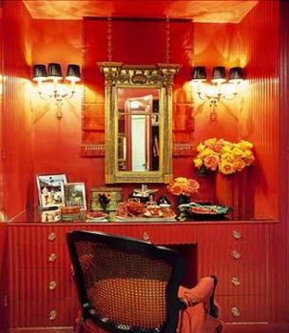
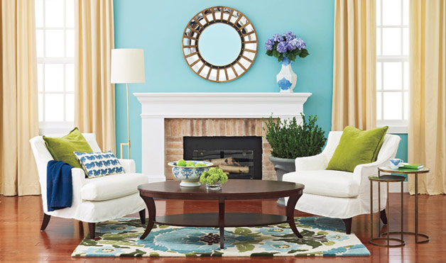
WARM v.s. COOL
Warm Colors: Red, Orange, and Yellow
Cool Colors: Blue, Green, Violet (Purple)

Slide 3
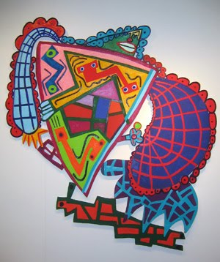
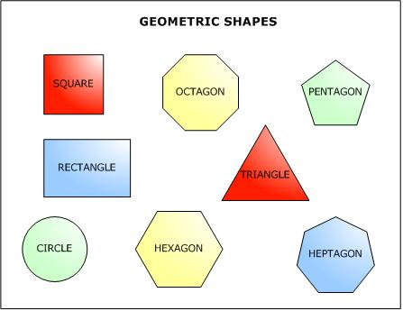
ORGANIC v.s. GEOMETRIC
Organic shapes – Can not measure the sides.
Geometric Shapes – Sides can be counted or measured (ex. Square, triangle, rectangle, etc.)

Slide 4
ABSTRACT What makes this artwork abstract?

Slide 6
Before we continue...
Let’s prep our materials!
Art caddy refill -- what colors are you missing?
Focus on COLORED PENCILS!

Slide 7
Open sketchbook to SKILLS activity from yesterday.
Homework assignment:
What song have you chosen for this project?
Objectives:
Learn about organic shapes and layering.
Practice patience and control when creating our artwork.

Slide 8
ORGANIC v.s. GEOMETRIC
Organic shapes – Can not measure the sides.
Geometric Shapes – Sides can be counted or measured (ex. Square, triangle, rectangle, etc.)

Slide 9
Practice!
Think about your song or LISTEN to your song.
Draw lines and shapes that represent your song.
From these shapes, we will begin our SKILLS project!

Slide 11
Draw out your organic shape.
1. Once drawn, we will cut it out.
2. Trace the shape 3 times on final artwork paper--THE SHAPE MUST OVERLAP.
3. STOP here and await instruction.

Slide 12
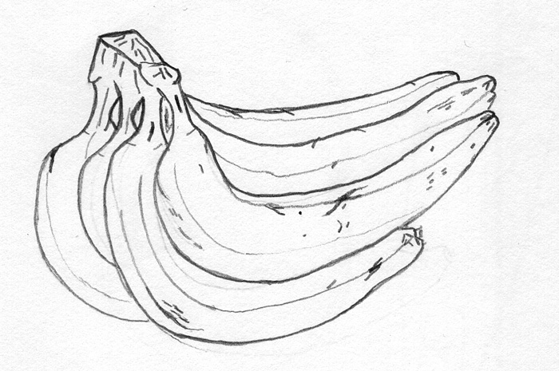
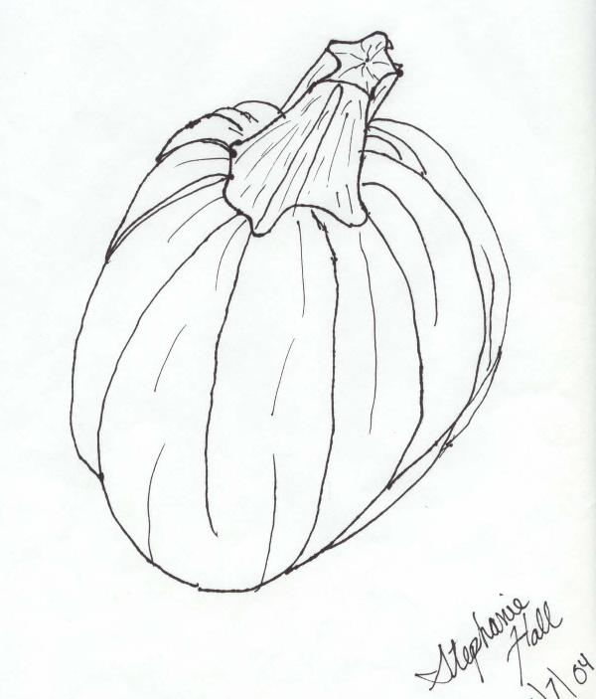
Contour lines
Contour lines define a form or an edge.
A simplified drawing of what you see.
Develops observation and control.

Slide 13
Requirements
Lines should be similar in width throughout artwork. Artist uses control to achieve this effect.
Composition should contain three overlapped shapes (the same shape repeated three times).
Composition should be interesting (good balance of positive and negative space).

Slide 14
OPTIONAL Collage Activity (This can be used as a sketchbook assignment)
Use a combination of drawing/coloring and collaging (cutting and pasting from magazines) to identify warm and cool color schemes.
*BE CREATIVE WITH YOUR DESIGNS AS ALWAYS ☺

