Slide 1
Think about your NAME in 3-d!
What might it look like?
What would it be made out of?
How would it be built?
*SHARE

Slide 2
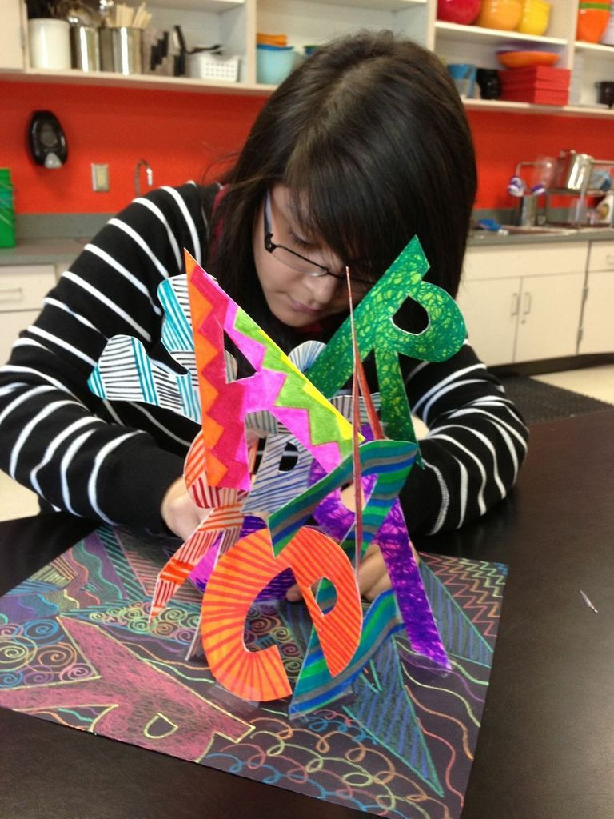
NAME SCULPTURES
Medium: Tagboard, markers, colored pencils, glue, and CREATIVITY!
Technique: Cutting,
pasting, sculpture.

Slide 3
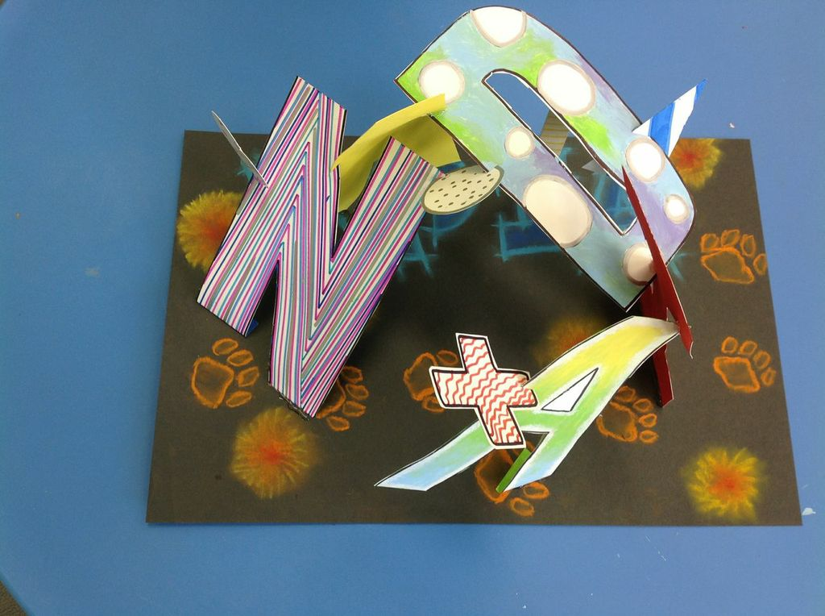

Slide 4
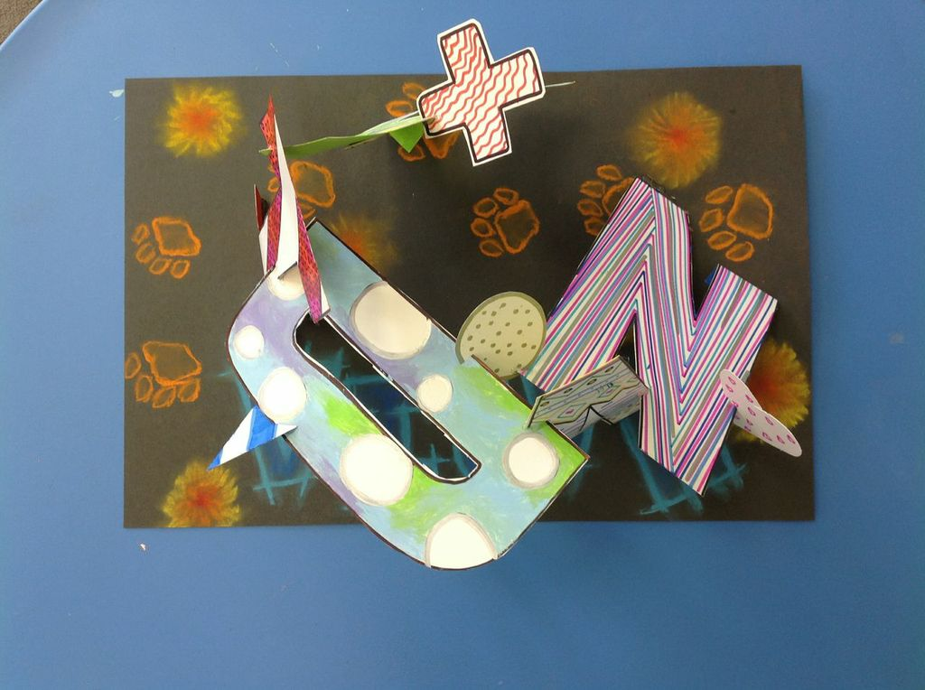

Slide 5
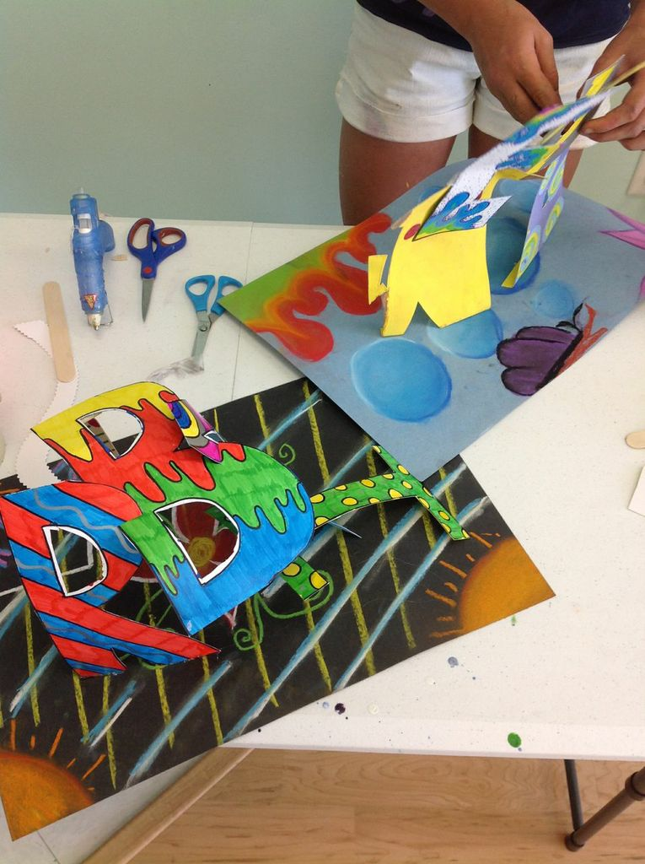

Slide 6
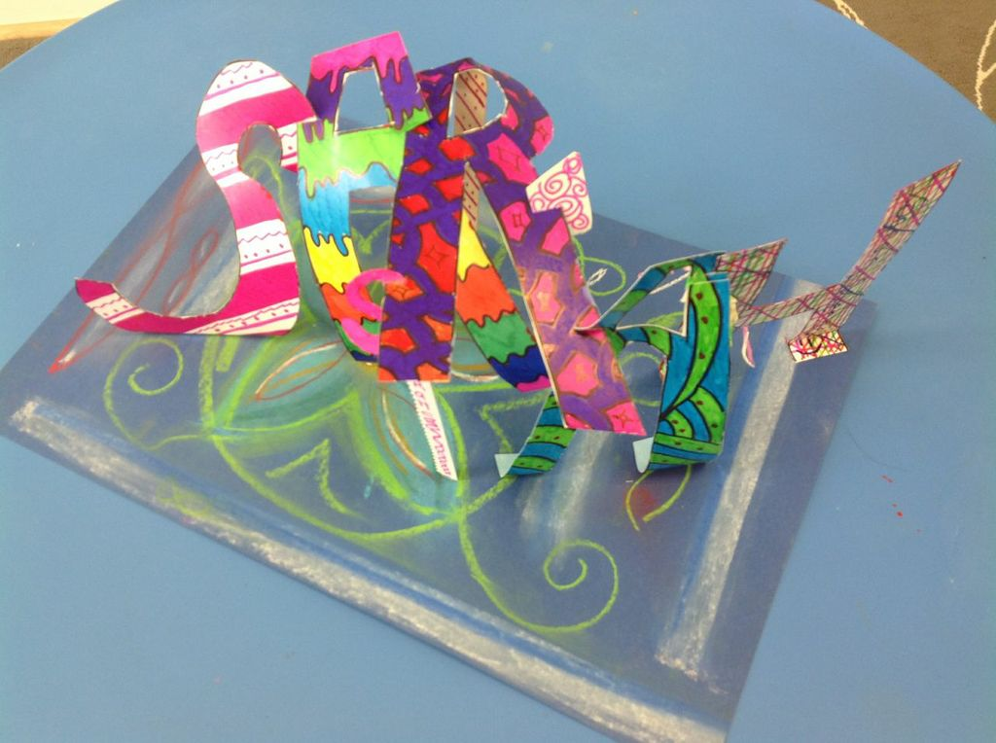

Slide 7
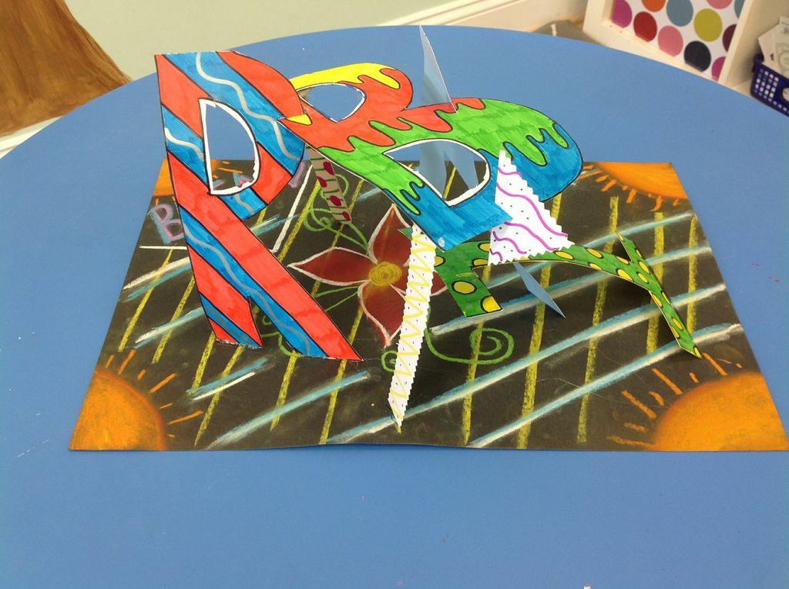

Slide 8
Objectives, Procedures & Criteria
Objectives: Students will demonstrate prior knowledge of the Elements of Art by creating a 3-dimensional name sculpture.
Procedures:
Pencil drawing of block/bubble names.
Decorate using colored pencils and markers (each letter must accurately represent an element of art.
Cut out and build.
*Grading Criteria: See General Project Rubric (will be discussed in detail)

