Slide 1
Artist Statement
Using the Language of Art

Slide 2
Artist Statements are Essential
On this planet (earth), people communicate with words and your artist statement introduces and communicates the language component of your artwork.
Just sayin’.....
“Earth without “art” is just EH”

Slide 3
Description (Describe your artwork)
Subject
Medium
Technique
Style

Slide 4
Description: Subject
Subject:
What is your artwork?
What is the focal point?
What can you easily identify in your work? If nothing specific…
What style of art is it?

Slide 5
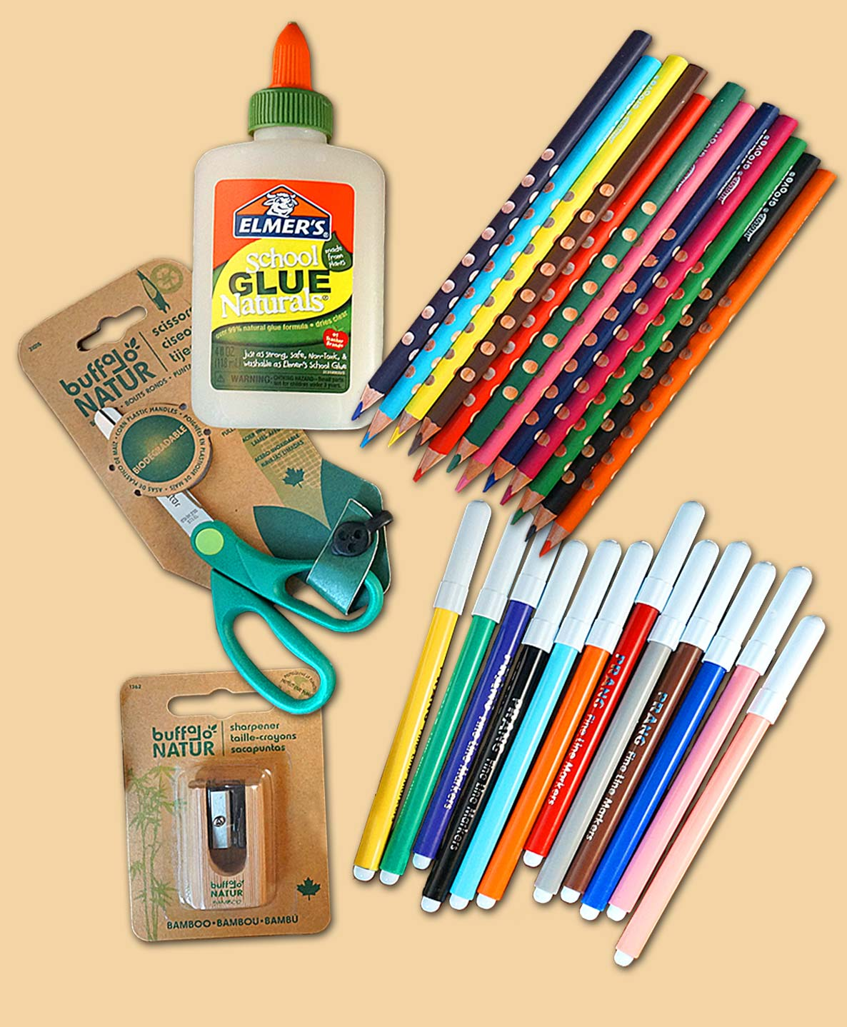
Description: Medium
Medium: ( What material(s) did you use?)
List all the tools you or the artist used?

Slide 6
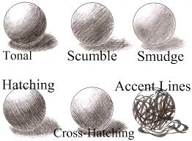
Description: Technique
Technique: (How did you use the materials?
General:
Drawing
Painting
Scratch Art
Sculpting
Specific: Shading, mixing, stippling, cutting, pinch/coil pots, etc.

Slide 7
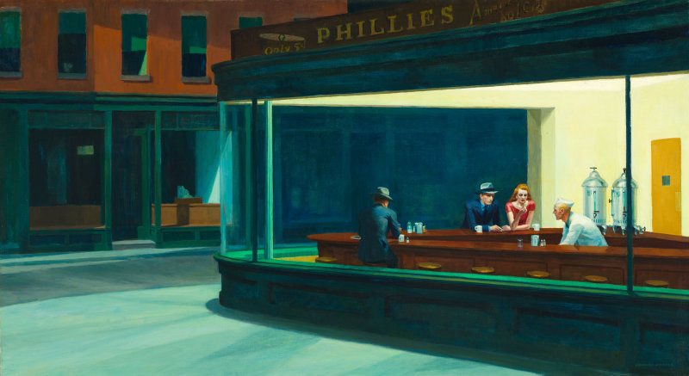
“Nighthawks” by Edward Hopper

Slide 8
Artist Statement: Analysis
Elements of Art and Principles of Design
What did you use in your artwork? Where and How? Provide specific details.
Elements of Art
Line, Shape, Color, Form, Texture, Value, Space
Principles of Art
Balance, Proportion, Rhythm, Movement, Pattern, Emphasis, Variety, Unity, Harmony, Contrast

Slide 11
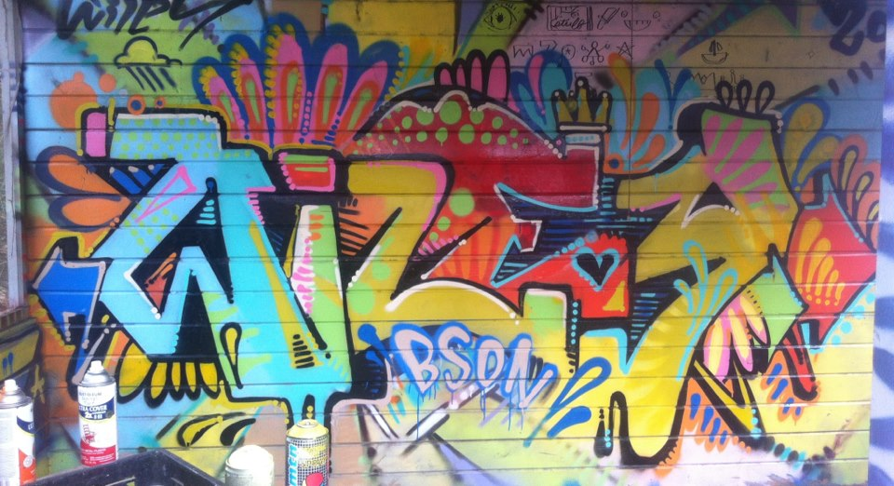
In partners, discuss 2-3 elements of art that are evident in this piece of artwork by Wiley Robertson (a graffiti artist).

Slide 12
In partners, discuss 2-3 principles of design that are evident in this piece of artwork by Wiley Robertson (a graffiti artist).

Slide 14
Interpretation:
Visual Message
What story or idea is your artwork communicating to the viewer?
Creative/Original Ideas
Explain how your artwork illustrates unique ideas.
Mood
How did you project feelings through your artwork to the viewer?
Symbolism
How did you communicate your ideas through visual images in your artwork?

Slide 15
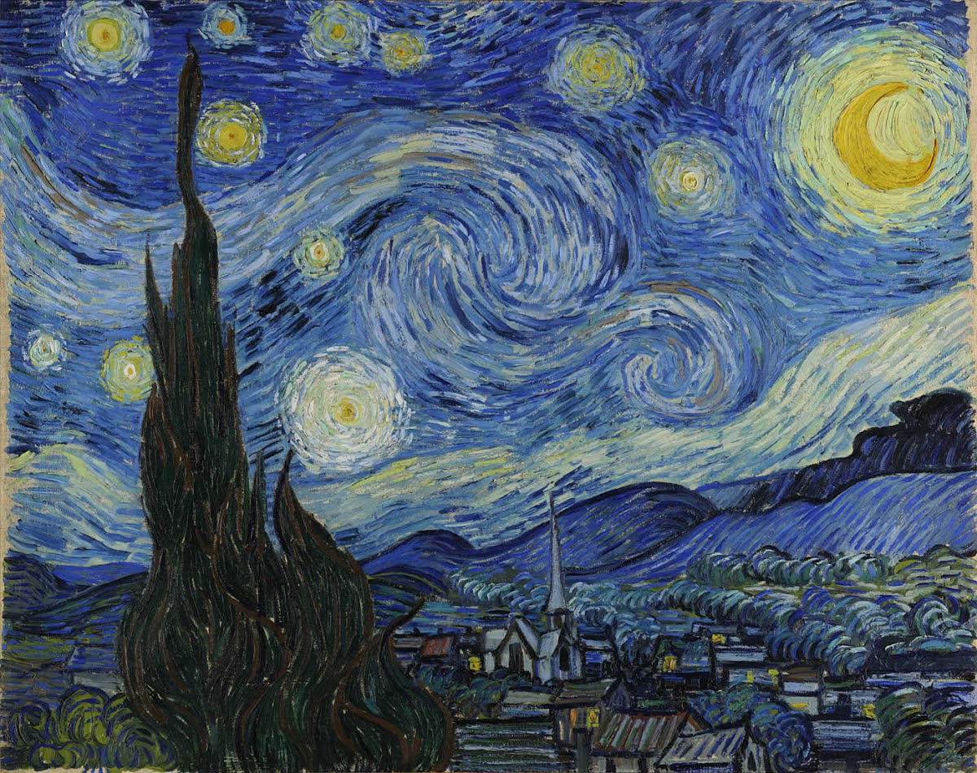

Slide 16
Growth
Ask yourself the following questions…
What did you learn during each S.K.I.L.L.S assignment?
What did you learn from each discussion topic?
What new materials did you use during this project?
What new techniques did you learn during this project?
What new art information (history, artists, vocabulary, etc.) did you learn about?
How did you improve your art skills?

