Slide 1
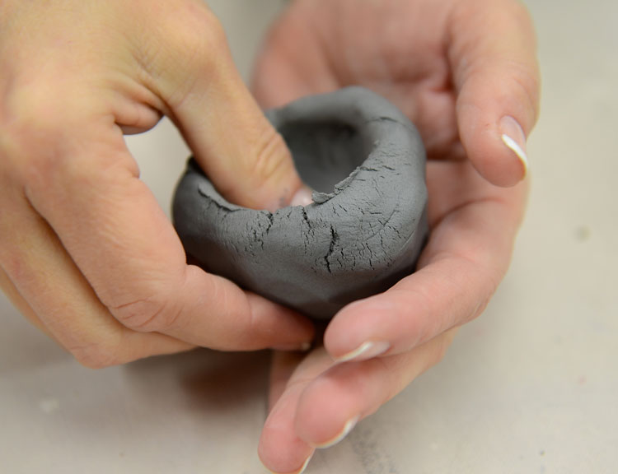
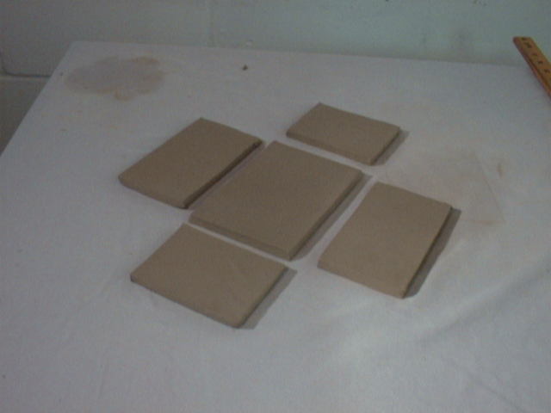
CLAY TECHNIQUES
Clay artists throughout the ages have invented many ways to shape things out of clay.

Slide 2
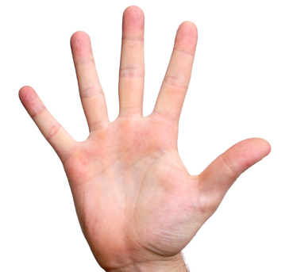
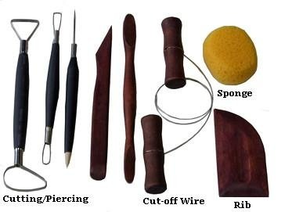
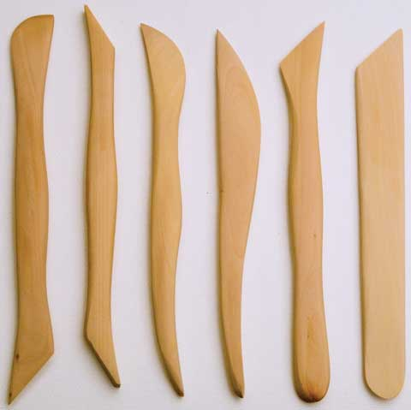
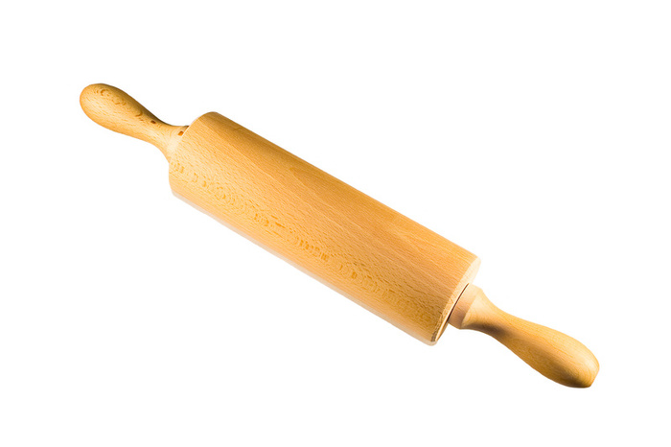
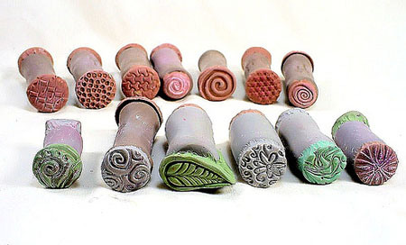
What are some TOOLS that are used with clay?

Slide 3
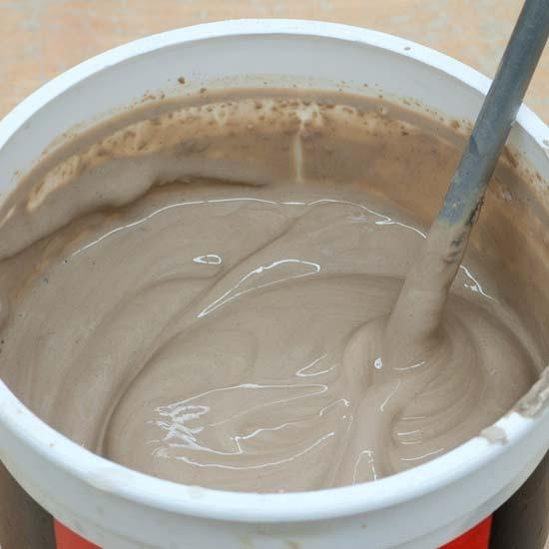
Building Projects
SLIP- Clay that has been diluted with water.
This is your GLUE!!

Slide 4
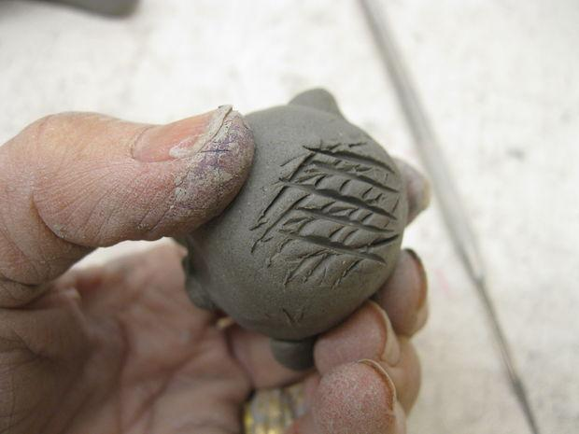
Scoring- This is when you use a clay tool to make marks in the clay so that 2 pieces can stick together.

