Slide 1
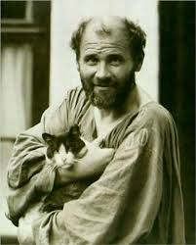
Gustav Klimt
Painter (1862–1918)

Slide 2
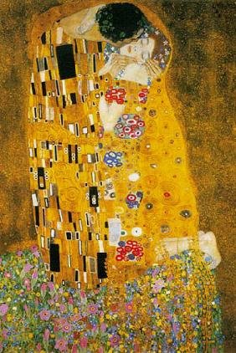
Austrian Painter
Most known for this painting called ….
The Kiss

Slide 3
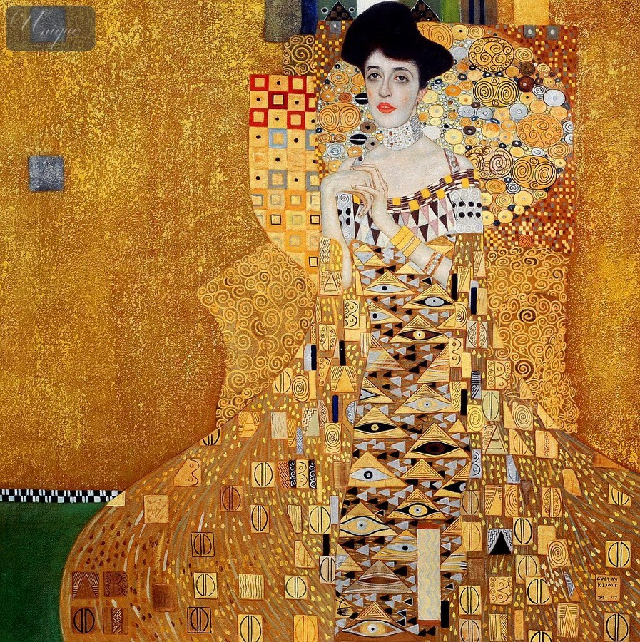
What is the first thing you see?

Slide 4
Pattern

Slide 5
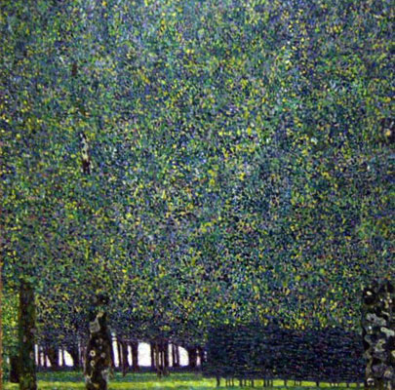
Known for the highly decorative style which were seen as a rebellion against the traditional academic art of his time.

Slide 6
Our focus for this project
Creating a Gustav style original art piece
-Focus on using the principles of design rhythm & pattern throughout composition.
-Focus on demonstrating the element of art space by creating a foreground, middleground and background to your artwork.

Slide 7
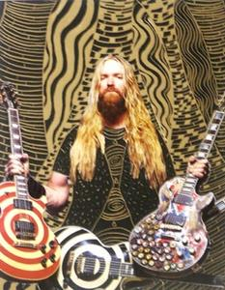
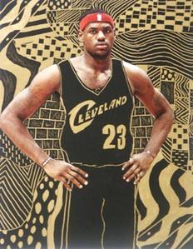

Slide 8
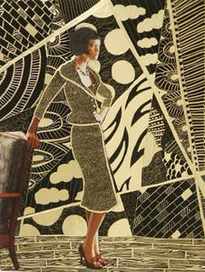
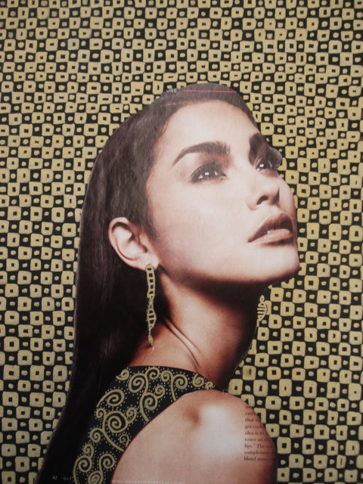

Slide 9
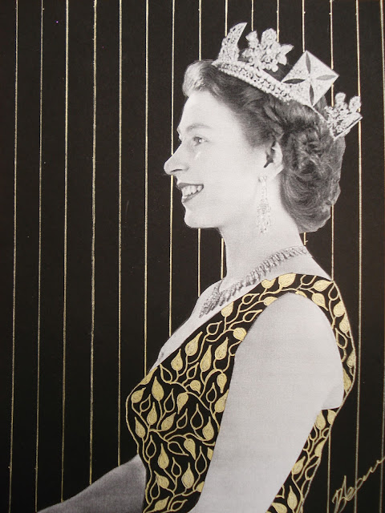
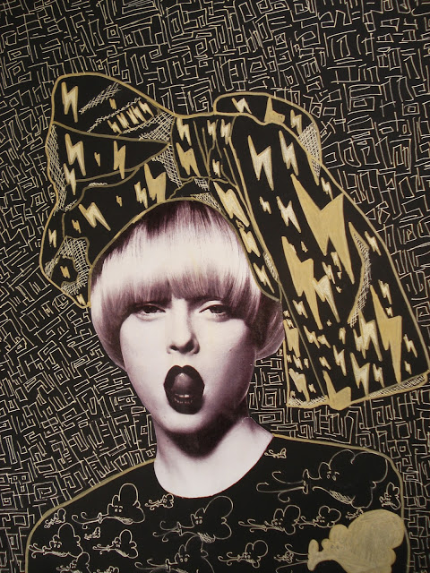

Slide 10
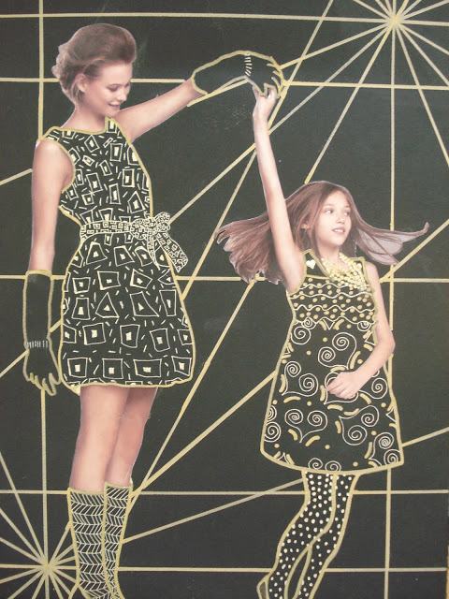

Slide 12
Carefully cut out the figure from the background

Slide 13
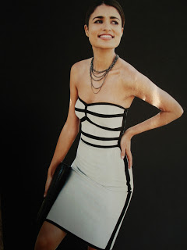
Place your figure on the black paper and carefully and lightly trace around it with a pencil

Slide 14
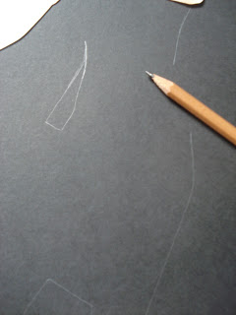
This is so you'll know where to re-glue the parts in the next step

Slide 15
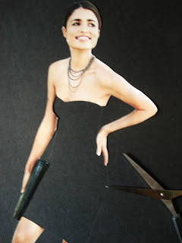
Now, cut away all the clothing

Slide 16
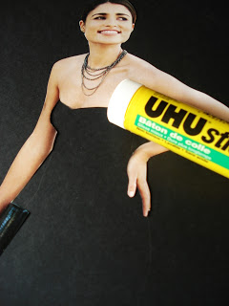
Then glue down, using a glue stick, all the 'flesh' parts. Use your traced guidelines
to help place all the pieces in the right spot.

Slide 17
Let’s Look at Patterns

Slide 19
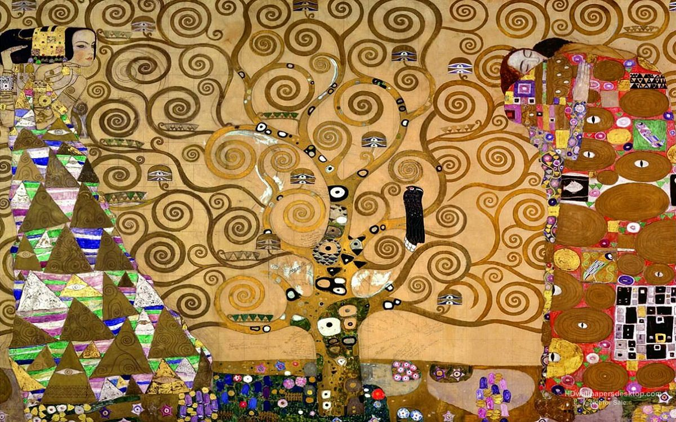

Slide 20
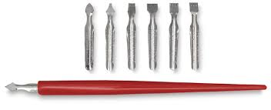
Scratch Tool Rules
Do NOT break them
Do NOT poke anyone
If you break one then you will have to replace it
You will turn it in at the end of the class I will come to each table to pick them up.

Slide 21
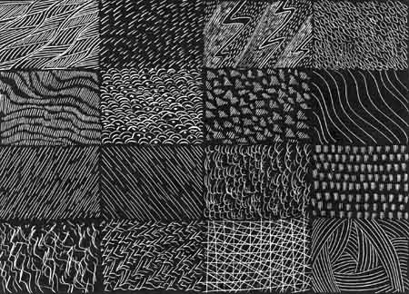
Let’s practice

