Slide 1
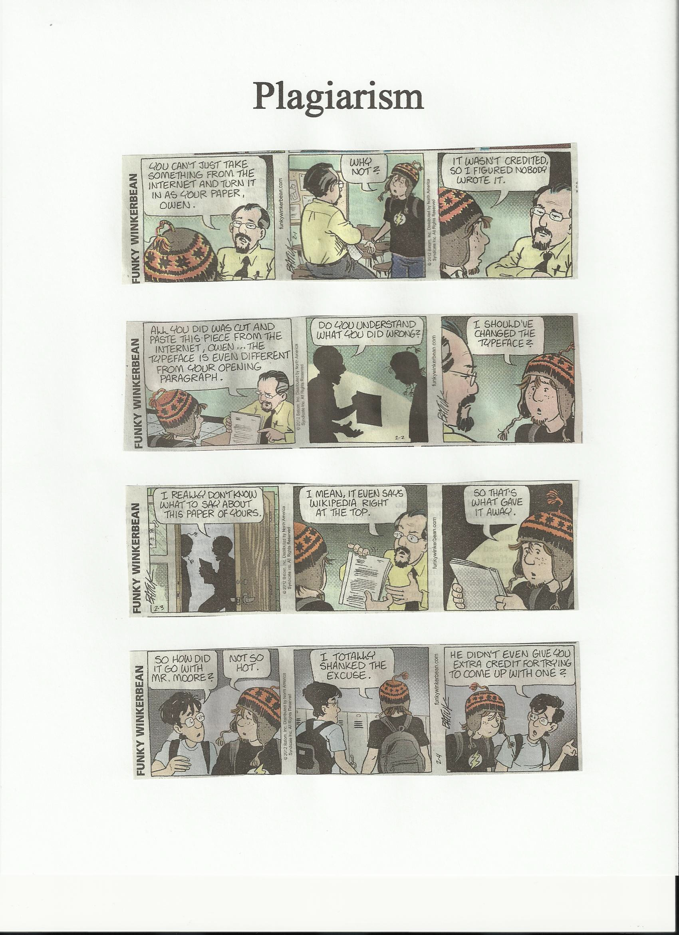

Slide 2
Plagiarism
What it is.
Avoiding it.

Slide 3
What is Plagiarism?
According to the Merriam-Webster Online Dictionary, to "plagiarize" means
to steal and pass off (the ideas or words of another) as one's own.
to use (another's production) without crediting the source
to commit literary theft
to present as new and original an idea or product derived from an existing source.
In other words, plagiarism is an act of fraud. It involves both stealing someone else's work and lying about it afterward.

Slide 4
Can words and ideas really be stolen?
According to U.S. law, the answer is yes.
The expression of original ideas is considered intellectual property, and is protected by copyright laws, just like original inventions.
Almost all forms of expression fall under copyright protection as long as they are recorded in some way (such as a book or a computer file).

Slide 5
What is considered plagiarism?
All of the following are considered plagiarism:
turning in someone else's work as your own
copying words or ideas from someone else without giving credit
failing to put a quotation in quotation marks
giving incorrect information about the source of a quotation
changing words but copying the sentence structure of a source without giving credit
copying so many words or ideas from a source that it makes up the majority of your work, whether you give credit or not (see our section on "fair use" rules)

Slide 6

Avoiding Plagiarism
Most cases of plagiarism can be avoided, however, by citing sources.
Simply acknowledging that certain material has been borrowed, and providing your audience with the information necessary to find that source, is usually enough to prevent plagiarism.
Use “Son of Citation Machine” (MLA style)
as found on the Internet. Label your sources
as “Works Cited” or “References” or “Sources”.

Slide 7
Works Cited for information on Plagiarism…
http://www.plagiarism.org/plag_article_what_is_plagiarism.html

