Slide 1
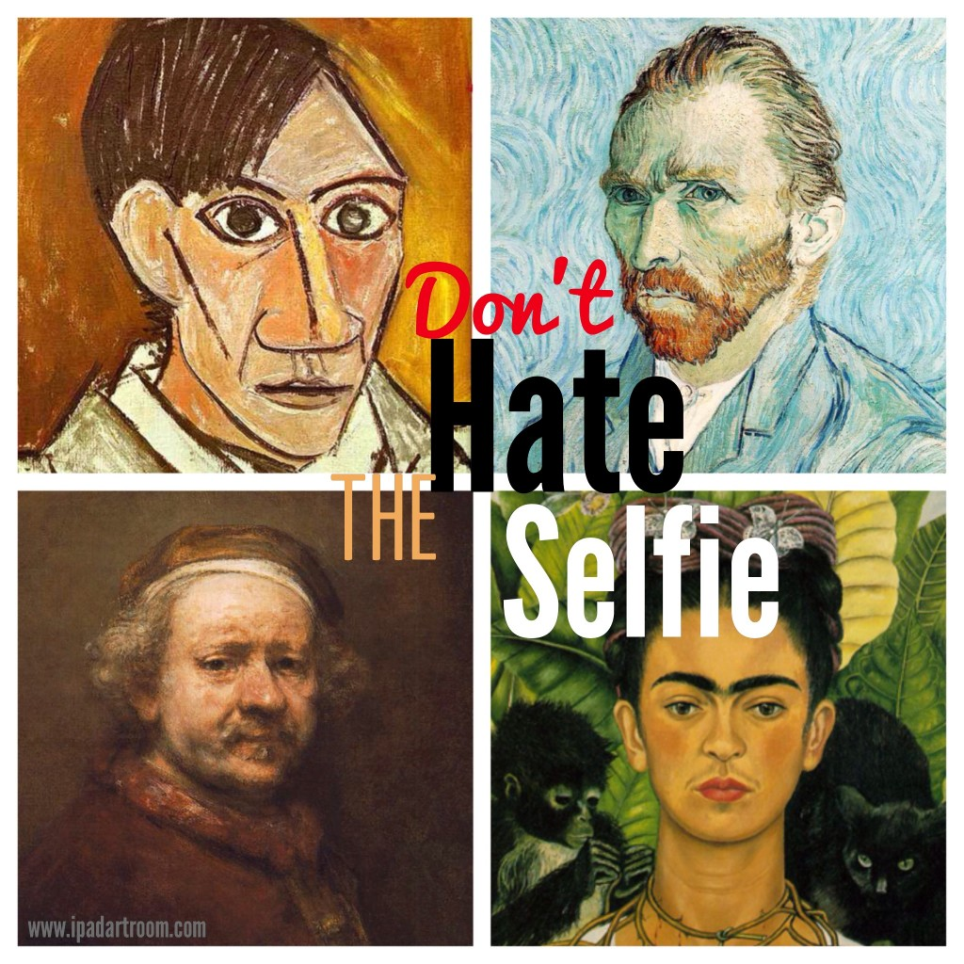

Slide 2
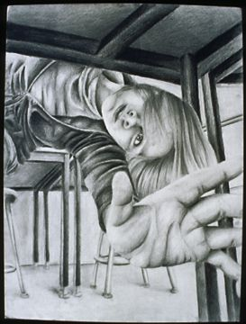
What is Value?
Perhaps the most important element of art when it comes
to drawing.
It can help create the illusion of form in a drawing or painting when used properly.

Slide 3
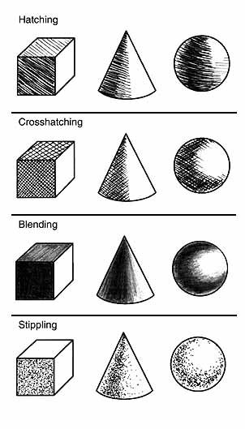
Different ways to use value
Hatching
Crosshatching
Blending
Stippling

Slide 4
Types of Graphite

Slide 5
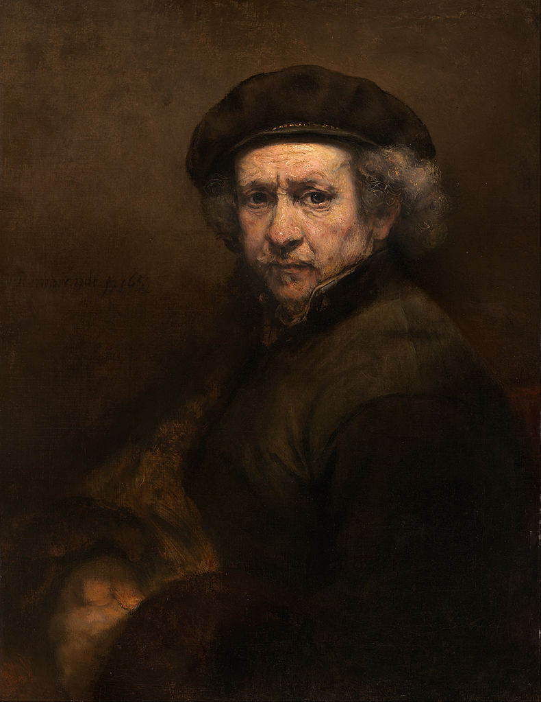

Slide 6
Self Portrait vs Selfie
self portrait is painted, drawn, sculpted
self portraits can be formal
selfie...silly faces, informal, usually posted on social media
selfie is instant in time, self portrait takes time

Slide 7
What is a self-portrait?
A self-portrait is a representation of an artist, drawn, painted, photographed, or sculpted by the artist.

Slide 9
What is a selfie?
http://www.youtube.com/watch?v=2j7SIxMGj5Q
A photograph that one has taken of oneself, typically one taken with a smartphone or webcam and uploaded to a social media website.

Slide 10
How to make a “selfie”
http://www.youtube.com/watch?v=vbqIQcKNE7E

Slide 11
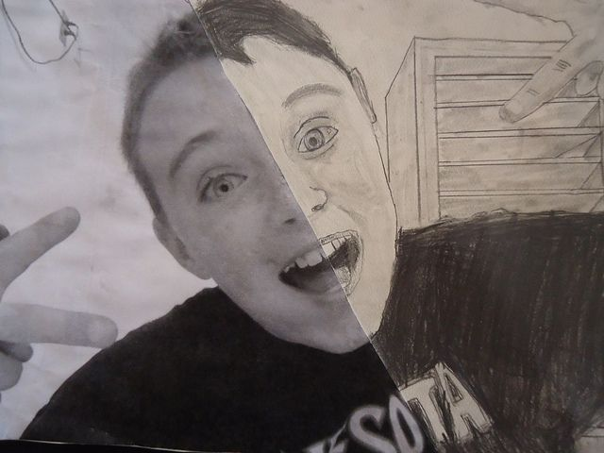
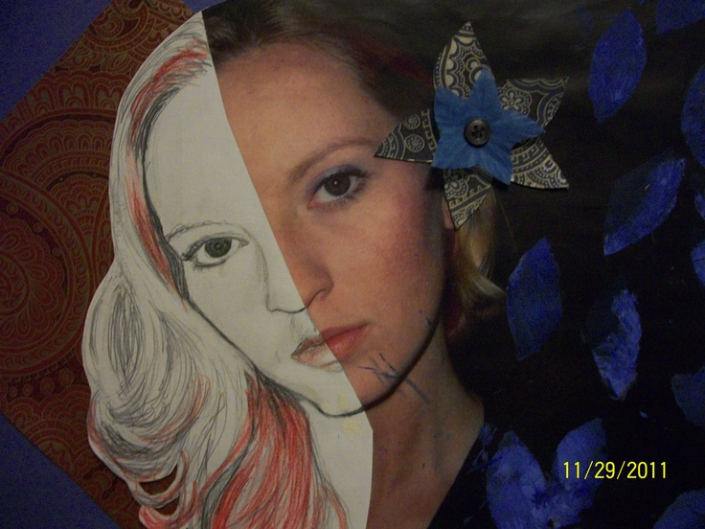
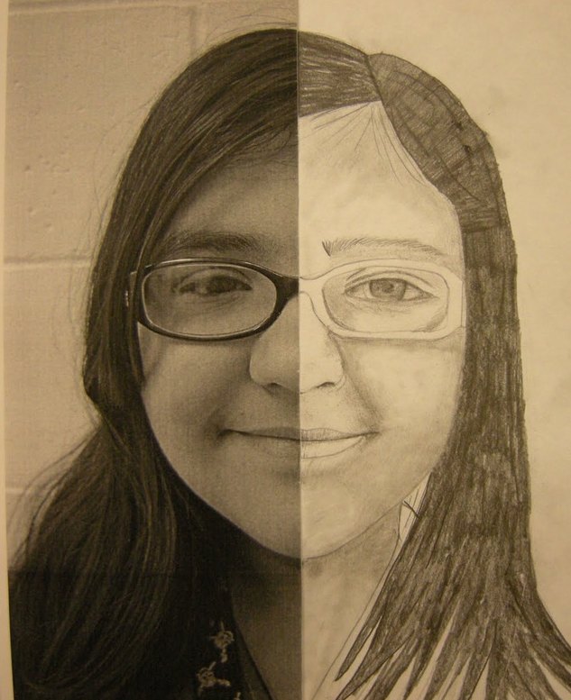
Using Symmetry to draw

Slide 12
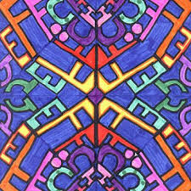
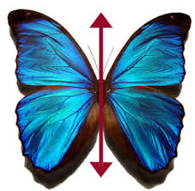
What is symmetry?
In a piece of art, symmetry is present in much the same way when the elements within balance each other… it helps with balance in an art piece.

Slide 13
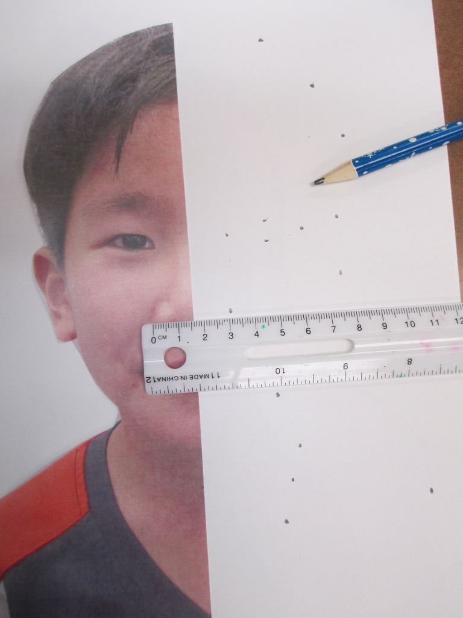
Using the line of symmetry to draw our faces
Using the ruler, students pick a starting point and measure how far it is from the line of symmetry.
Then they measure that exact same distance on the opposite side, marking the spot with a dot

Slide 14
For example, Eiki started with his eye. He measured and learned that the inside corner of his right eye was 1.25 cm from the line of symmetry.

Slide 15
This helped him know that his left eye must also be 1.25 cm from the line of symmetry.
So he measured 1.25 cm and made a dot there.
Next he measured the distance from the center to the outside corner, making a dot on the opposite side

Slide 16
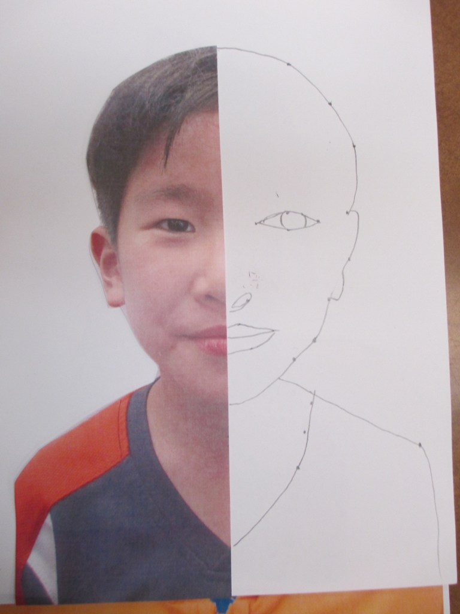
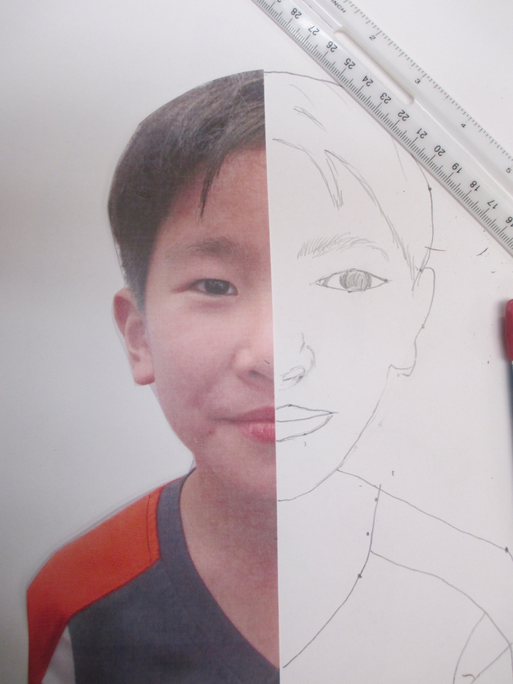
Dot-to-dot drawing

Slide 17
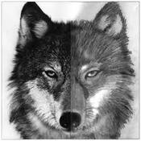
SKILLS - Symmetry Drawing

Slide 18
Project Examples

Slide 19
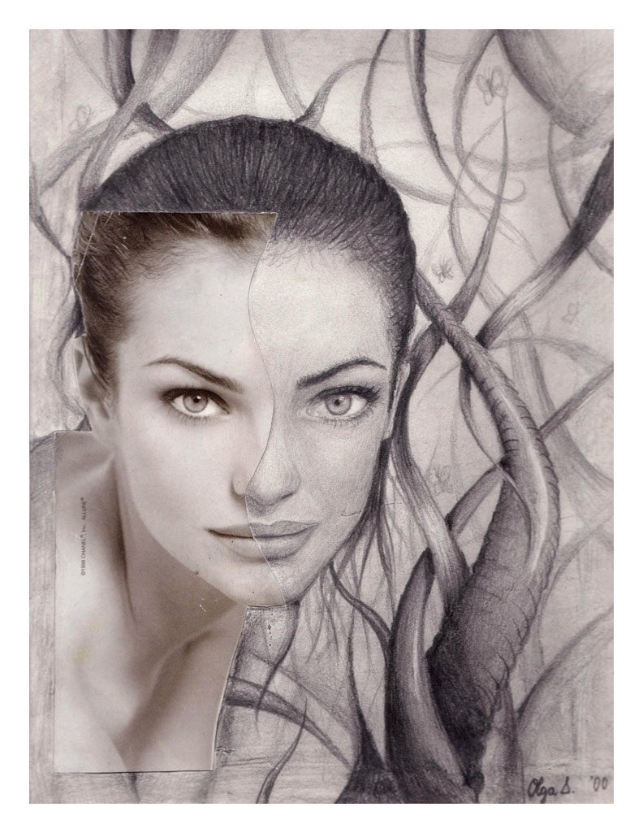
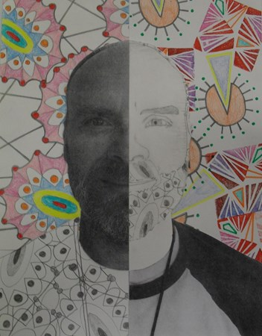
Background

Slide 20
