Slide 1
DREAM ILLUSTRATION
Directions: Think of a dream you’ve had and draw it on paper. Include the colors, people, setting, chain of events, etc.
If you can’t recall a dream, create a dream-like setting with real or imagined objects or people.

Slide 2
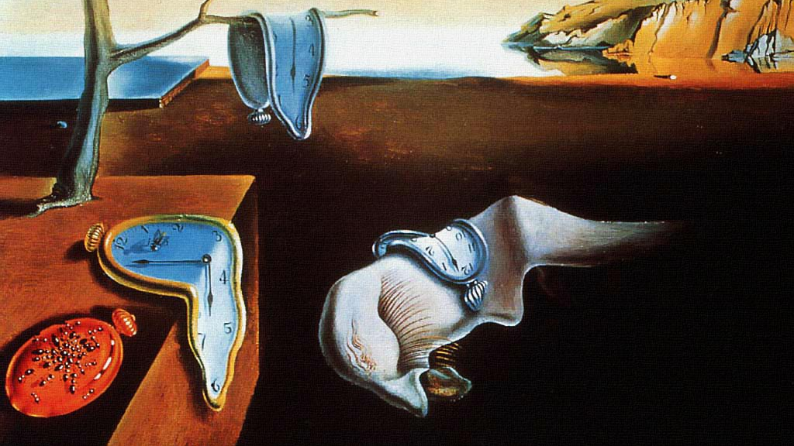
SURREALISM
Artist: Salvador Dali

Slide 3
STYLE: Surrealism
Group consisting of writers, artists, and filmmakers.
Surrealists looked to the unconscious, and to dreams to produce their work.
Irrational, daring, shocking, and sometimes confusing work.

Slide 4
Common Characteristics of Surrealism
DREAMLIKE
UNCONSCIOUS/SUBCONSCIOUS
TRANSFORMATION
COMPLEX
IMAGINATION
MIX UP SUBJECTS and LOCATIONS

Slide 5
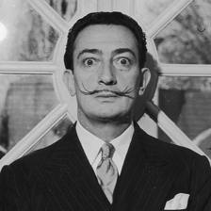
Artist: SALVADOR DALI
Born in Spain
Working in oils at age 10 and producing accomplished work by age 15.
Painted in styles such as impressionist, cubist, and surrealist.
Joined the Surrealist art movement in 1929

Slide 6
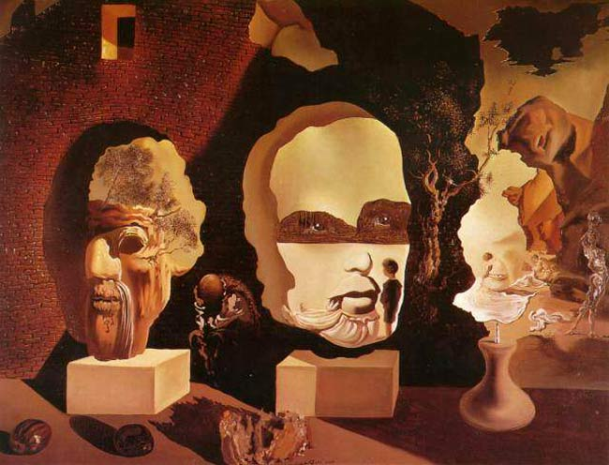
Old Age, Adolescence, Infancy (The Three Ages)

Slide 7
The Disintegration of the Persistence of Memory

Slide 8
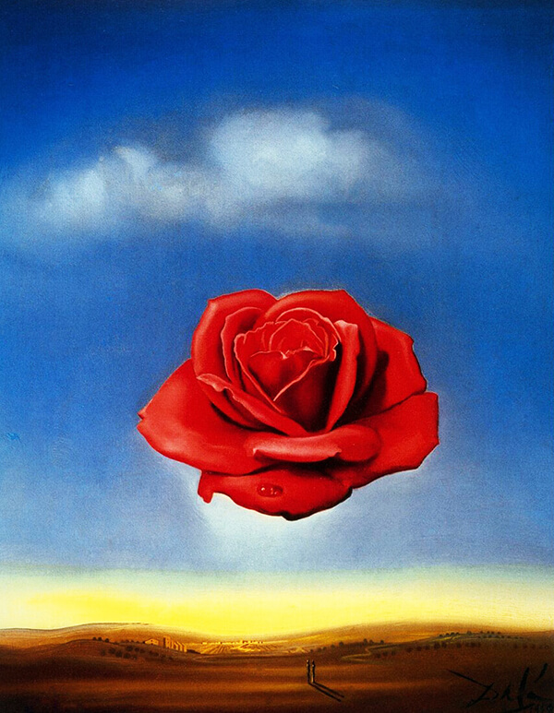
Rose Meditative

Slide 9
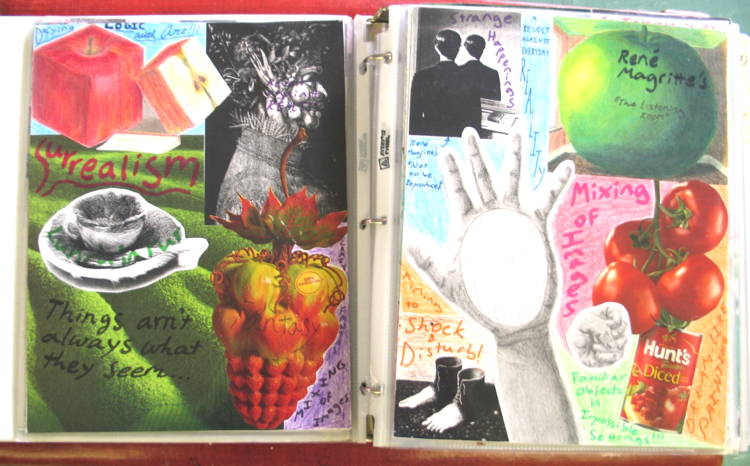

Slide 10
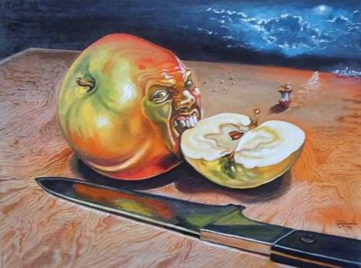

Slide 11
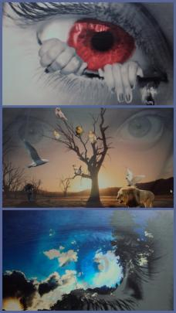

Slide 12
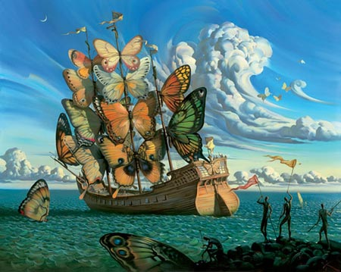

Slide 13
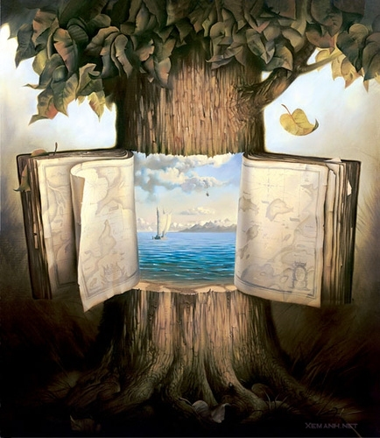

Slide 14
Surreal COLLAGE
For surrealists, collage was a way of taking completely unlike objects or images and putting them together in the same piece of art to surprise and even shock the viewer – the same way dreams do.
Juxtaposition – Putting two different things side by side that don’t normally go together
Dislocation – When objects are placed where they shouldn’t be (Mixing subjects and locations).
Transformation – Turning something familiar into something unusual, shocking, or disturbing.

Slide 15
Surreal COLLAGE Cont.
Directions: Using a variety of magazines and your own drawings combined, create an interesting collage that represents SURREALISM. *You will use this only as inspiration for your FINAL Surrealist piece of artwork (rough draft).

