Slide 1
Symmetrical Name Towers

Slide 2
Fold your sheet of paper in half..

Slide 3
Write or print your first name.
Write big or it will not show up!

Slide 4
Go over the pencil with black marker.

Slide 5
Fold it back in half...you will be able to see the black marker through the paper....

Slide 6
Trace over that with the black marker again.

Slide 7
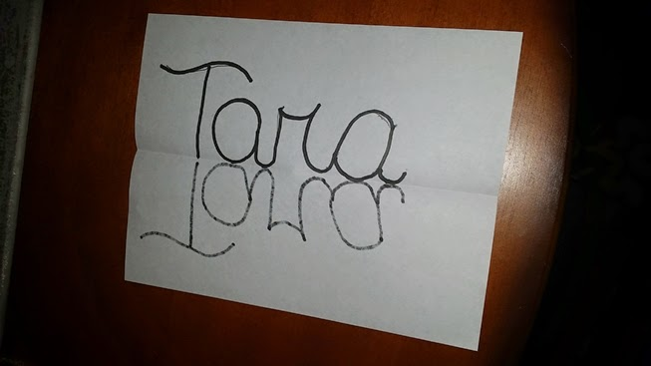
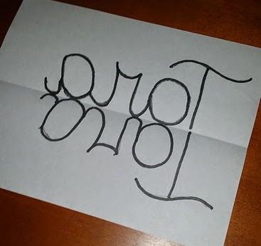
Open the paper.
Trace it one more time.

Slide 8
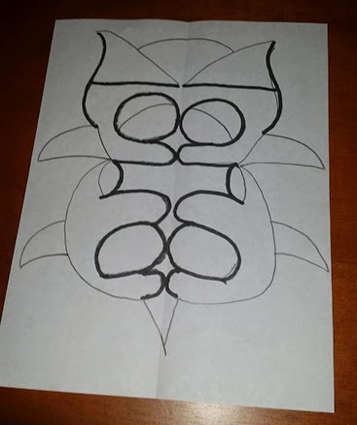
Now you have the name on both sides.

